Slide 1
A Brief Intro to SQL for CSS
June 15th, 2021

Slide 2

What is a Database?
Structured Data that is stored
Can be accessible
Can be modified
DataFrame Parent

Slide 3
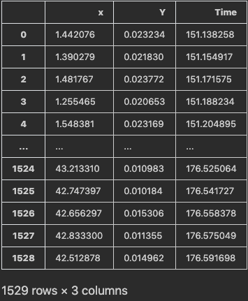
What is Structured?
Organized Data
Searchable Data
Rows/Columns/Databases
20% of Data in Companies
(SQL) known as “Relational”

Slide 4


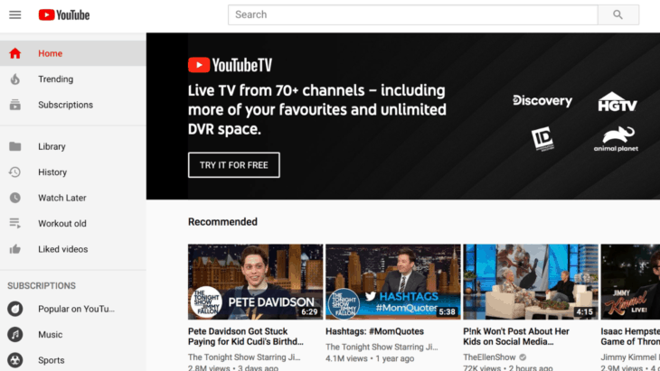
What is Unstructured?
Everything else (80%)
Not Searchable, or Displayable
No clear Rows/Columns/Databases
Can include audio, video, emails, etc.
(SQL) known as “NoSQL”

Slide 5

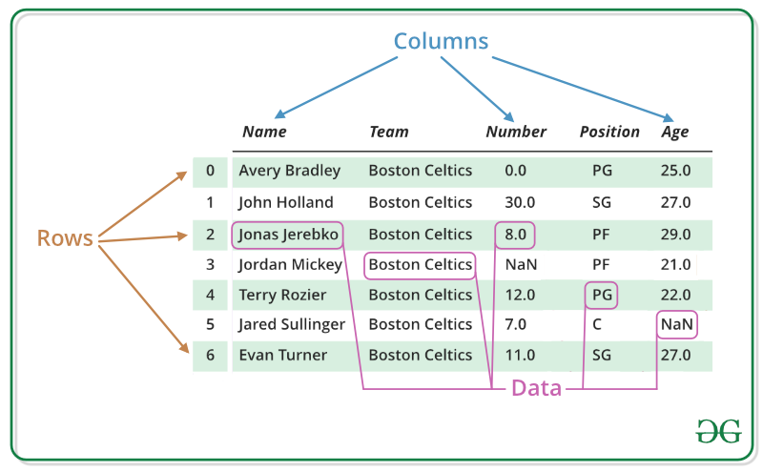
What is Pandas?
Python Data Analysis Library
One version!
Meant for Data Analysis and Manipulation
Single DataFrames or Tables at a time

Slide 6

What is SQL?
Structured Query Language
  Pronounced however you want
  Structured English QUEry Data Language or Sequel
Multiple Versions!
  My SQL, SQL Server, Oracle

Slide 7
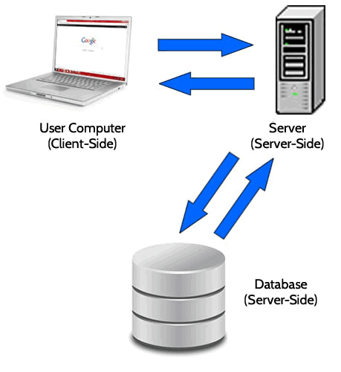
What is SQL?
A Database Management System (DBMS)
Can access multiple tables!
Cannot conduct complex analysis!
Easier on the you + the computer
  Server does the heavy lifting
SQL Query
DBMS
Location of Database

Slide 8
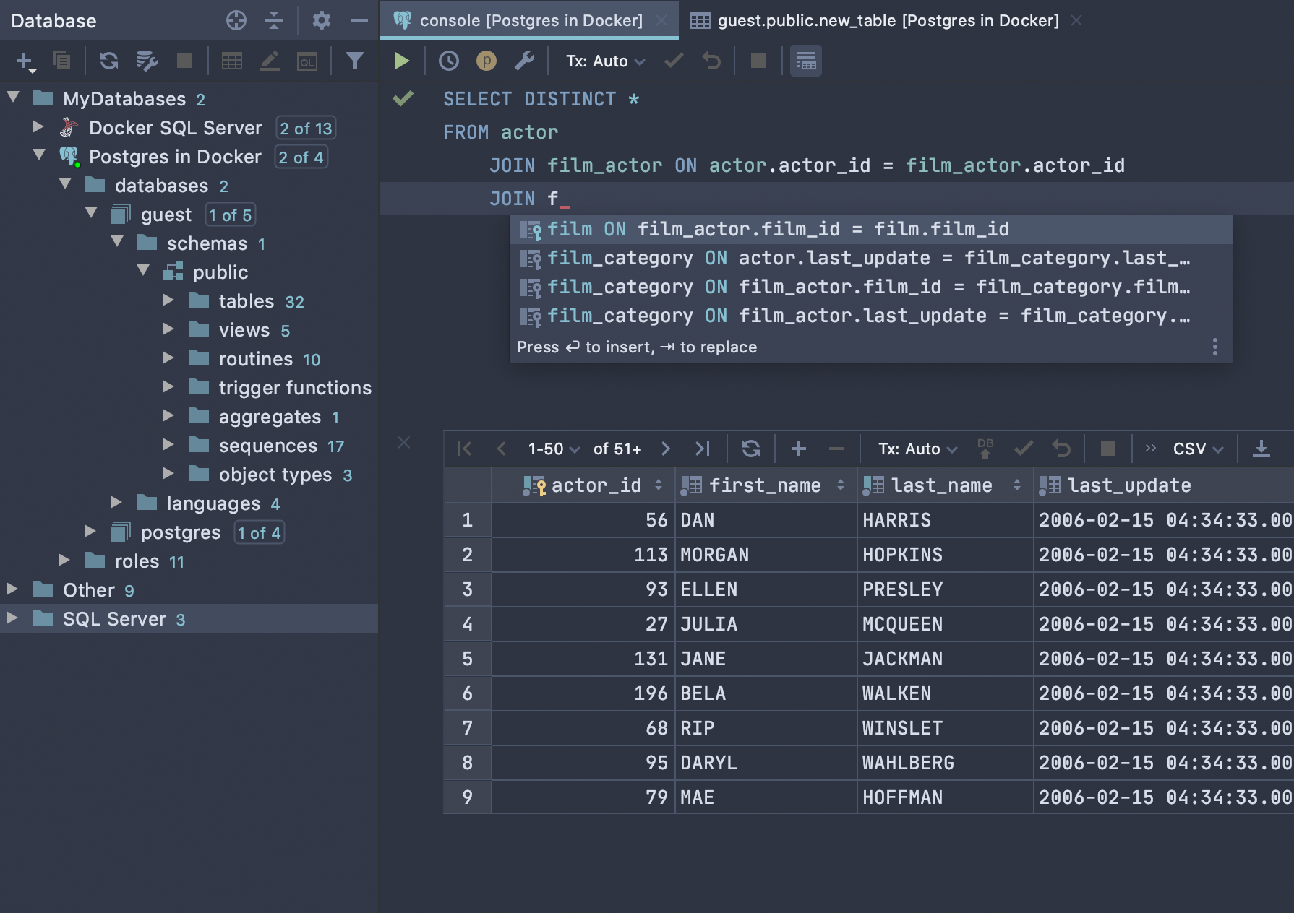
What does SQL Code Look Like?
Query Language
  Python is Line-By-Line Object-oriented (matplotlib) + Functional (def)
Code “Declares” vs. Reflects
Datagrip by Jetbrains

Slide 9
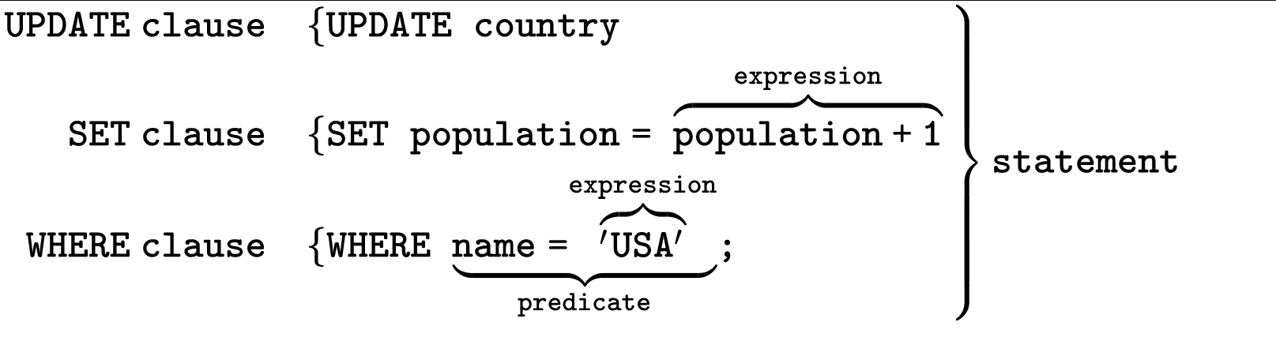
What does SQL Code Look Like?
index = 0
for row in country[USApopulation]:
    country[index, USApopulation] = row + 1
    index += 1
loop
Python
SQL

Slide 10
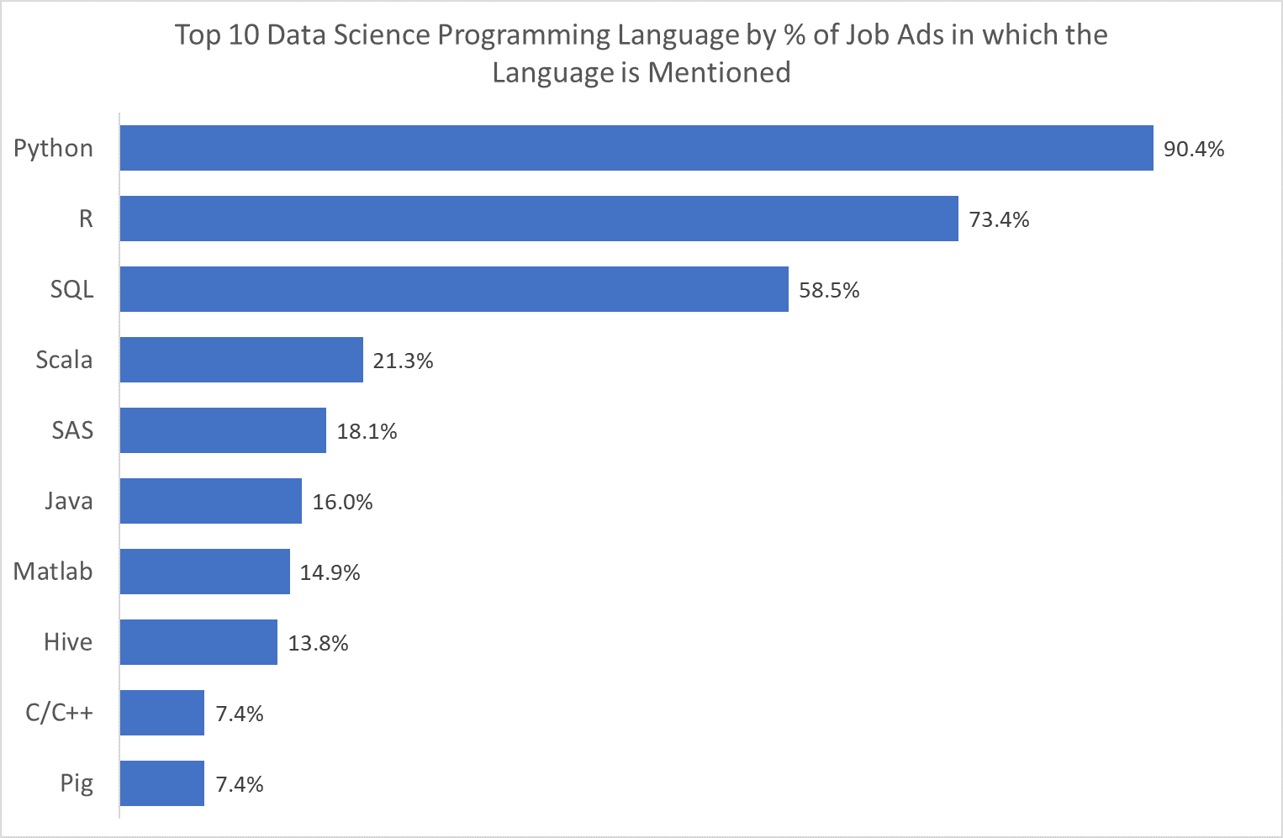
Why learn SQL?
Extremely useful for working with Huge sets of data
Favored in Job Applications
Ease of transition between SQLs
Useful tool for pulling data (think of web scraping)
Can be used directly in Python (library package)
https://towardsdatascience.com/which-programming-language-should-data-scientists-learn-first-aac4d3fd3038

